Slide 1


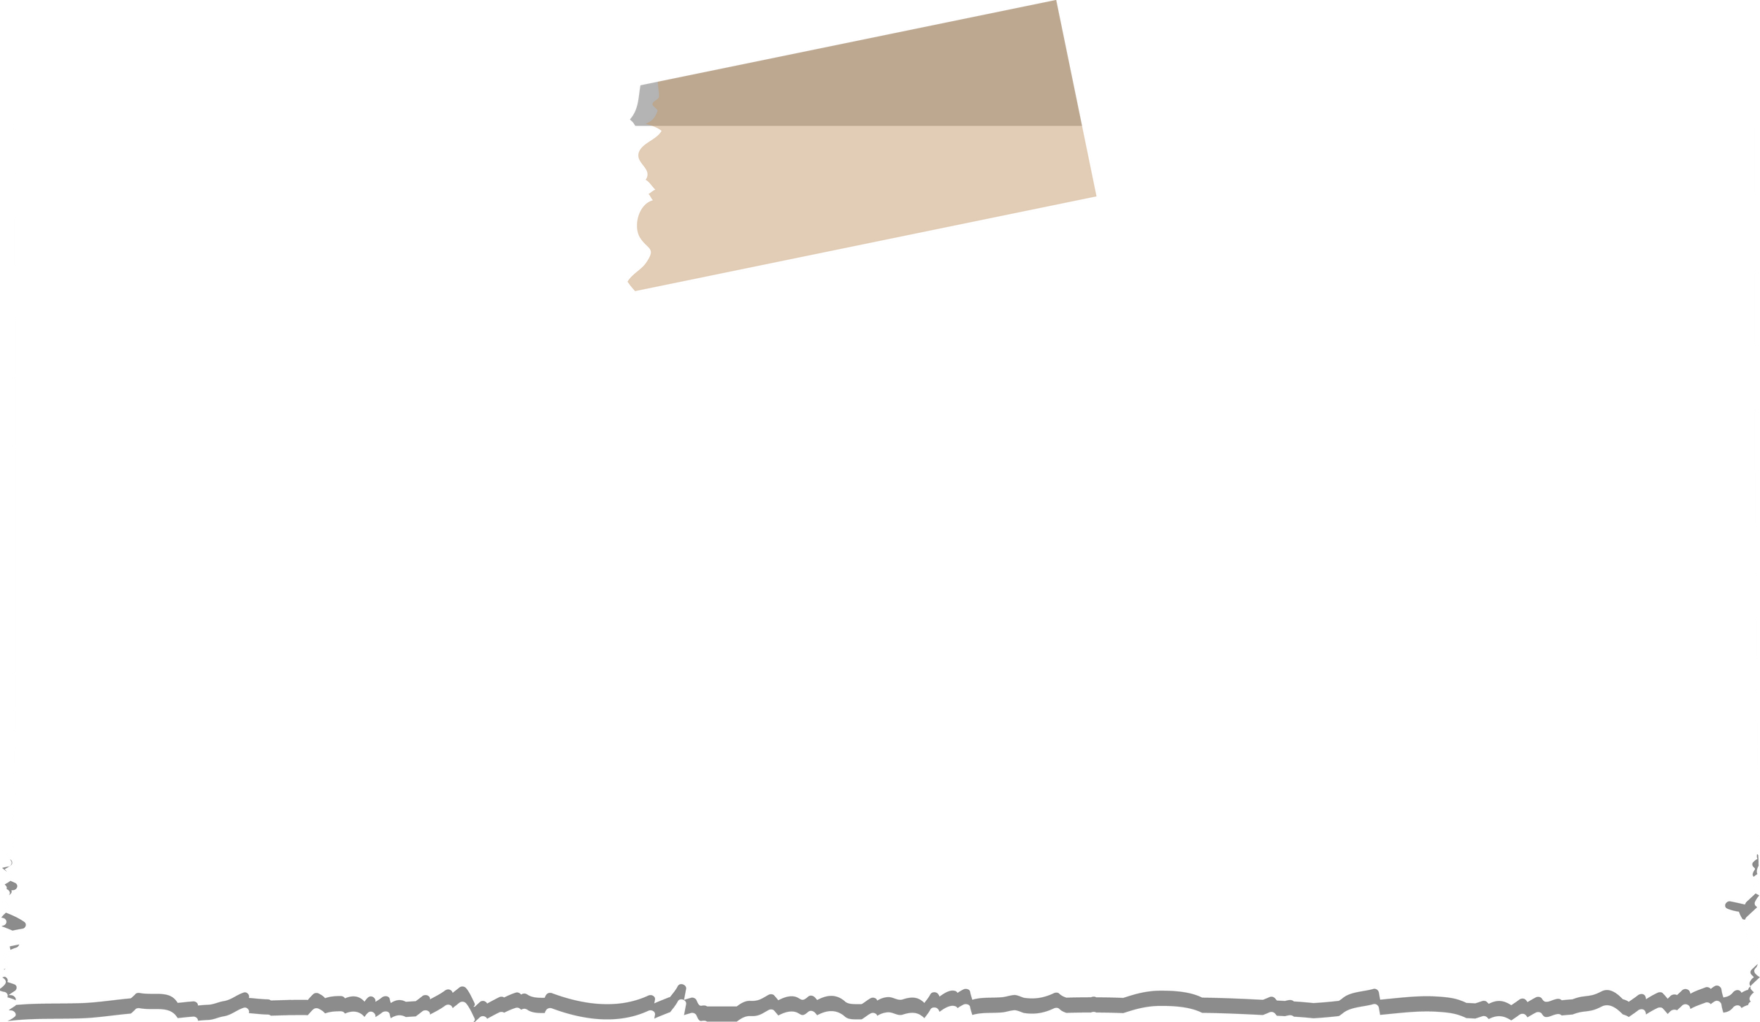



What are global issues?
Prepared by Ms.Ancila

Slide 2





The IB has defined global issues in the following manner:
(a) they have significance on a wide/large scale;
(c) the impact is felt in everyday contexts.
b) they are transnational;

Slide 3



How do I narrow myself down from one of these areas?

Slide 4
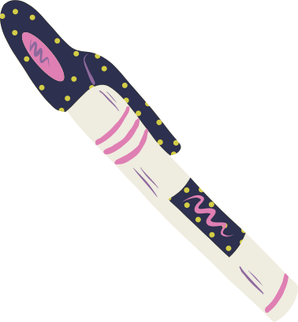

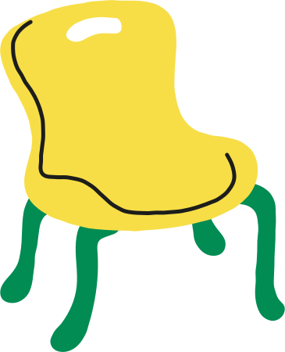
"It is important to note that the term global issue need not necessarily be understood as a problem, obstacle or threat; it may also refer to a social phenomenon that is internationally significant but manifests itself in
local contexts, such as living in a digital society" (21)
To break it down even further, and to use more student friendly language, a global issue has to be big, cross borders, but also be felt in someone's hometown. Keep this definition in the back of your head as you move to the next section of creating your own global issue.

Slide 5



How do I narrow myself down from one of these areas?
Your global issue must connect to an extract from a literary work (and the larger work it comes from) and your global issue must connect to a non-literary extract (and larger body of work).

Slide 6



Example #1
I am interested in the first field of inquiry: culture, identity and community. More specifically, I am interested in this idea of identity. I love thinking about "who am I"? But identity is NOT a global issue. It's too broad. To narrow it down, I need to consider what about identity am I interested in exploring (in what I have studied) - in my case, fatherhood. If I narrow it down to what it means to be a father in Great Britain in World War One, it's no longer a global issue. That's too narrow. So now I need to combine the two in a way that still fits the definition of a global issue. I can start with a question: what does it mean to be a father? I can then add to the question since being a father during times of peace might be different from being a father in times of war. I now have a global issue that works: what it means to be a father in times of war.
Too broad: Culture, identity and community
Still too broad: Identity
And still too broad: Fatherhood
Too narrow: Fatherhood in Great Britain in World War One
Too wordy and convoluted: Fathers who take care of or abandon their children when they have to go to war or not go to war.
Just right: What it means to be a father in times of war

Slide 7
Example #2
I'm interested in SDG #4 - quality education (it's also one of the key words in the 2nd field of inquiry). But quality education is still a bit too broad; it's not a global issue yet. I need to ask myself some questions. What about education interests me? What makes a "good" or "quality" education? I believe children and teens have a right to education. But is it "rights" that I want to explore or is it something else about education that interests me? What have I studied in class that connects to education? I also think I want a positive individual oral. I live in Singapore and they regularly top the international league tables for educational outcomes and test scores. Wait, if I focus just on one country, that's too narrow. Well, in my school, my teachers keep talking about education as a force for good in the world. I think that's it!
Too broad: Education or quality education
Still too broad: Educational rights
Too narrow: Singaporean education system and why it's so good
Too long and convoluted: the ways in which education systems allow students to have agency and take action combatting problems they face in the world around them
Just right: education as a force for good

Slide 8
Example #3
I love technology. I want that to be my global issue! Wait, that's too broad. It's just one of the words in the fifth field of inquiry. What about technology is interesting to me (in what I have studied)? I'm interested in the ways in which governments are using facial recognition technology. But that's too narrow! I think it should be something about the intersection of ethics and technology. But that's too broad? How do I merge all my ideas together?
Too broad: Technology
Still too broad: Technology and ethics
Too narrow: How Facebook uses facial recognition technology for commercial means
Too long and convoluted: Governments controlling its citizens through technology and spying on them through this technology to keep them compliant or to jail them in the future
Just right: The use of technology to monitor protest movements

Slide 9




Key tip: keep the global issue as short as you can without compromising on the idea. That doesn't mean the global issue is one word! But if it takes you two sentences to state the global issue, that's too long!

Slide 10








Do you have a final checklist I can use for my global issue?
1. Is your global issue "big" enough? Does it have large scale or wide significance?
Proof: (write your answer in your Learner Portfolio)
2. Is your global issue transnational? Can you name several different countries where this is true?
Proof: (write your answer in your Learner Portfolio)
3. Can your global issue be felt in everyday contexts? Do you notice it in your neighborhood?
Proof: (write your answer in your Learner Portfolio)
4. Is the exploration of your global issue manageable in a 10 minute oral? In other words, is your global issue too long or too short? Is it trying to do too much?
Proof: (write your answer in your Learner Portfolio)
5. Can a regular, everyday person - like a parent or guardian - understand your global issue without you having to explain it in more detail? Can you say it to them only once and do they "get" it? If you have to explain your global issue to them, or if you have to say more, or if you need to qualify something, most likely, you still need to refine your global issue.
Proof: (write your answer in your Learner Portfolio)

